Slide 1
Traffic Manager

Slide 2
Traffic Manager
DNS based traffic load balancer.
A service allow you to distribute traffic to public facing applications across global Azure regions.

Slide 3
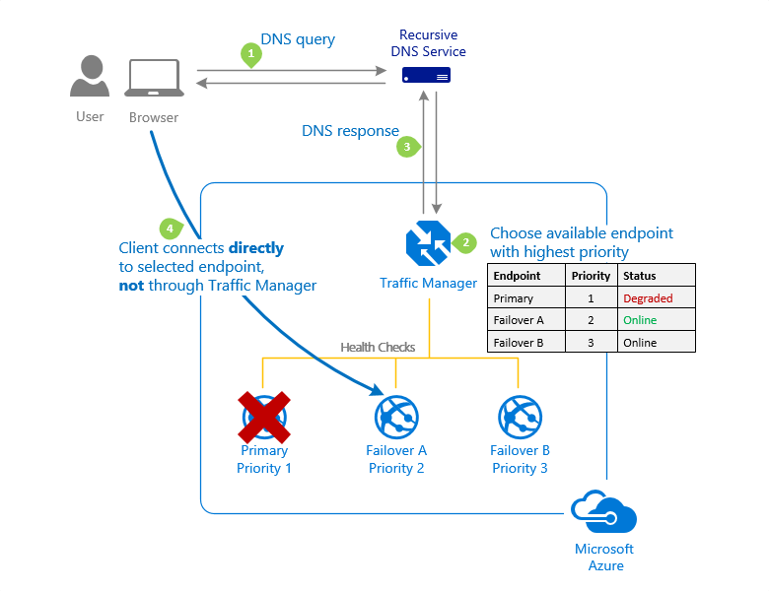











Slide 4
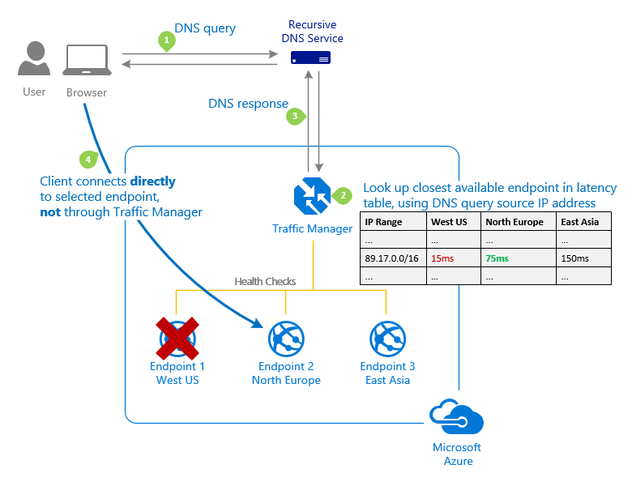

Slide 5
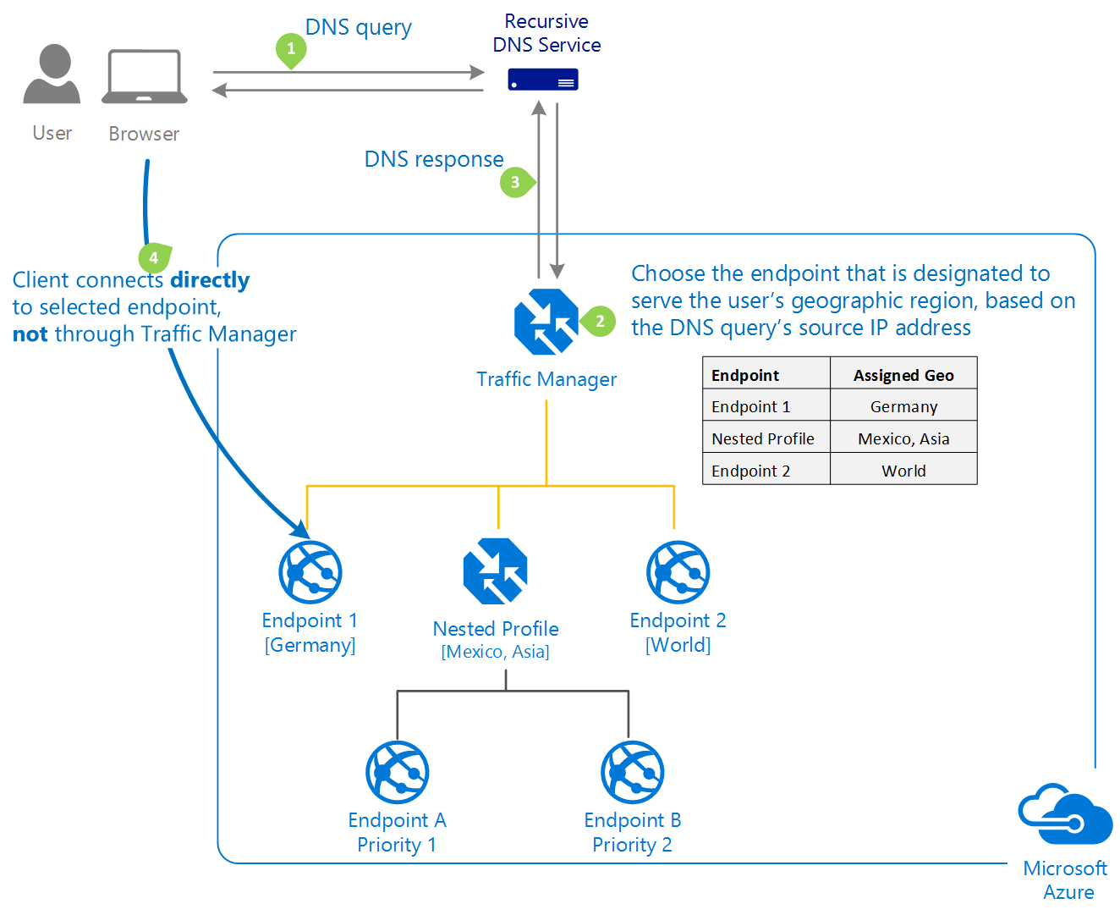

Slide 6
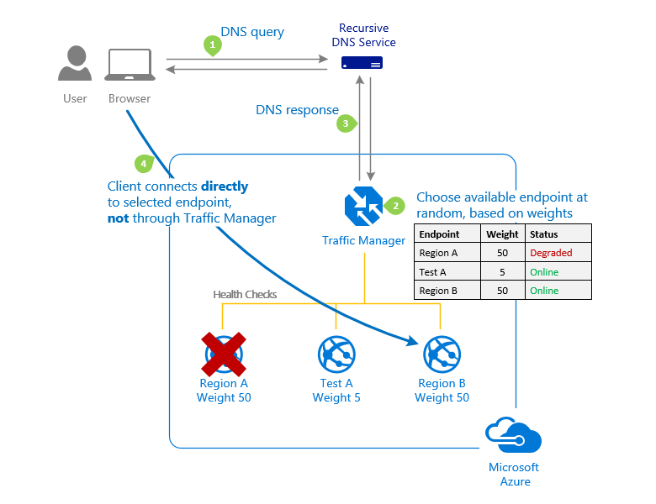

Slide 7














